Slide 1

TAKORADI TECHNICAL UNIVERSITY
BACHELOR OF TECHNOLOGY IN INFORMATION TECHNOLOGY II
FACULTY OF APPLIED SCIENCE
COMPUTER SCIENCE DEPARTMENT
DATA MANAGEMENT AND ANALYTICS
END OF FIRST SEMESTER MINI PROJECT
REPORT
GROUP 11
BANSAH BLESS
BC/ICT/22/315
(level 300)

Slide 2
AN ONLINE BANKNG SYSTEM
TECHNOLOGIES USED
PHP
HTML
CSS
BOOTSTRAP
WEB BROWSER
EXCEL
MY SQL
Features
Public
Login Page
Announcement Page
About us Page

Slide 3
AN ONLINE BANKNG SYSTEM
Client-Side
Dashboard Page (display the account number and current balance)
List of Transactions History
Deposit
Withdraw
Fund Transfer
Manage System Credentials
Admin Side
Dashboard Page
List of All Transactions History
Deposit for Client
Withdraw for Client
Fund Transfer for Client
Manage System Credentials
Manage System Settings/Info

Slide 4
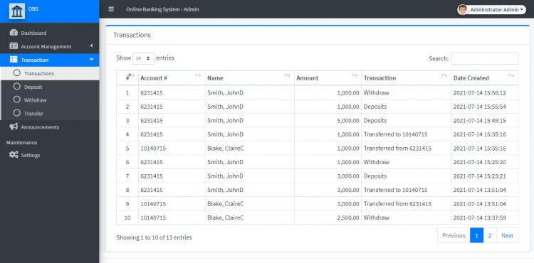
IMAGE
This is a Simple Banking System Project that I'd developed in PHP. The project manages the bank's clients' accounts and handles the basic transactions of the clients. The system has 2 types of users which are the Admin and Clients. The system allows the client to save the records of their Deposits, Withdraws, and Fund Transfers.

Slide 5
About the Banking System
This Simple Banking System web-based project was developed using PHP, HTML, CSS, JavaScript (Ajax and jQuery), Bootstrap, and some other plugins/libraries. On the Admin Side, the system admin user can manage all the records of the clients' accounts and the admin can also make the transaction for the walk-in clients. The admin is also in charge of managing the announcements which will be posted on the public website where all their clients or possible clients can read the post. Then, on the Client Side, as I have mentioned above, the client can make their transaction using the system and also track all their transactions. The system has many minor features which are relevant for this kind of system such as some Error trapping to prevent system errors due to human errors. The clients' credentials can be only created by the admin user.

